Slide 1

Effective Data Visualization for Large Meta-Analyses: Evidence from a Randomized Survey Experiment
David Khella, Avery Charles, Dr. Kaitlyn Fitzgerald

Slide 2
Background
Meta-analysis is the statistical method for synthesizing results across multiple studies that investigate the same phenomenon.
Current practice is to visualize the results via bar plots or forest plots
Notes:
After first bullet point:
Example: education context… new proposed curriculum to improve student scores, multiple studies to test its effectiveness
Use/stick to education context because this is the context in which we ran this experiment; however, applicable to other contexts as well

Slide 3
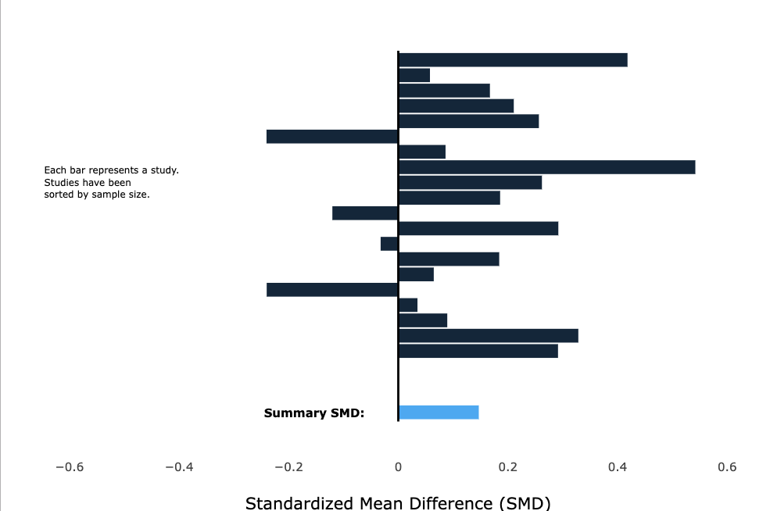
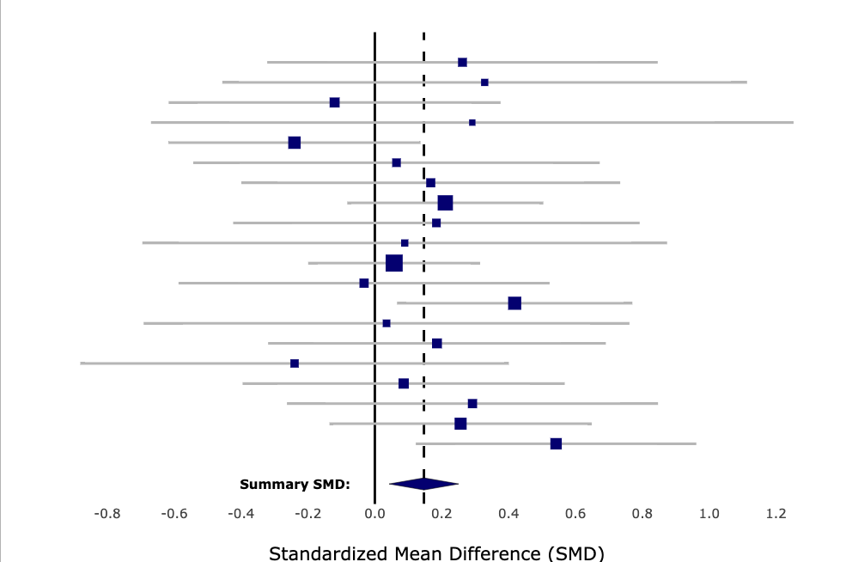
Background
Bar Plot
Forest Plot
Notes:
Bar Plot:
Each bar is individual study
Length of bar (x-axis position): effect size; measure of curriculum’s performance
At the bottom: summary effect size, calculated by meta-analysis
No explicit way of showing uncertainty
Forest Plot:
Each square represents individual study
Horizontal position of squares: effect size determined by study
Size of squares: weight in determining summary effect
Grey bars: confidence intervals around each point estimate
Summary effect: diamond at the bottom (center: summary effect size, width: confidence interval)
Common meta-analytic visualizations and their conventions

Slide 4
A Key Idea
The key to meta-analytic reasoning: the summary effect is a weighted average with studies that are more certain getting more weight
Any visualization that makes that idea more obvious by displaying weight should perform better

Slide 5
The Problem
Bar Plot
Forest Plot
Notes:
Bar Plot:
Does not display weight (or any measure of uncertainty)
Forest Plot:
Displays weight but uses unfamiliar/uncommon conventions
Size of squares (unless told that, audience may not know)
Width of confidence interval (wider interval = less certainty = less weight, assumes some statistical expertise)
For both: we want the most attention at the summary SMD (bottom), but other visual distractions
Bar Plot: the longest bar (the study with greatest effect size)
Forest Plot: widest confidence interval (study with least weight)

Slide 6
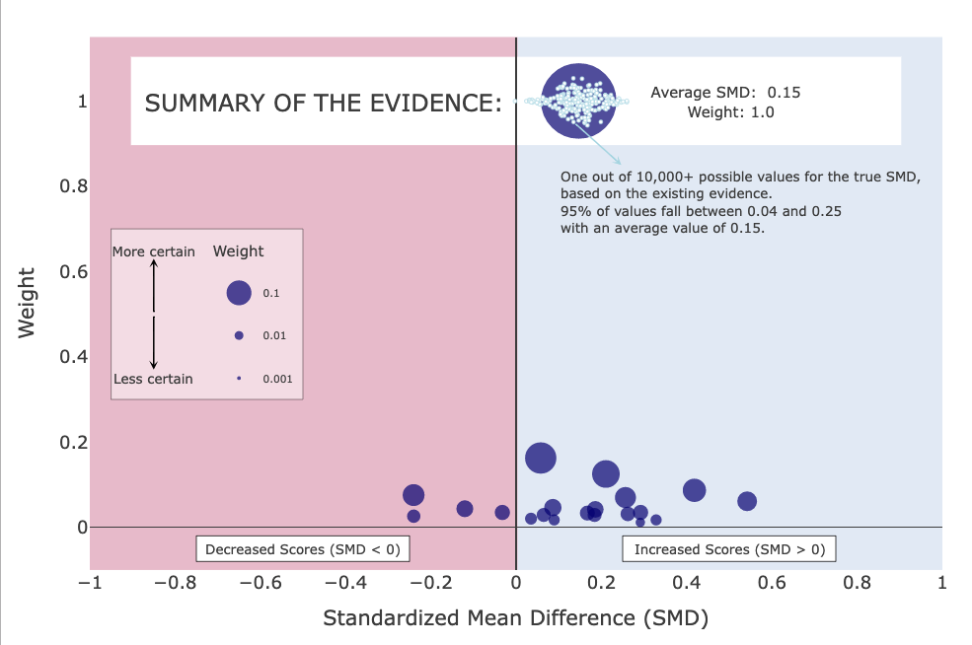
The MARC Plot
Outperforms bar plot and forest plot for small meta-analyses
Fitzgerald & Tipton (2022)
Notes:
Each point is an individual study
Horizontal position of point corresponds to effect size
Weight (doubly encoded)
Height on y-axis
Size of points
Summary effect (where we want most visual attention): at the top highlighted in white; cloud of points = confidence interval around the summary estimate
Legends and annotations

Slide 7
Purpose of Experiment
Evaluate whether the advantages of the MARC plot still hold for larger meta-analyses
Propose and test an updated MARC plot design

Slide 8
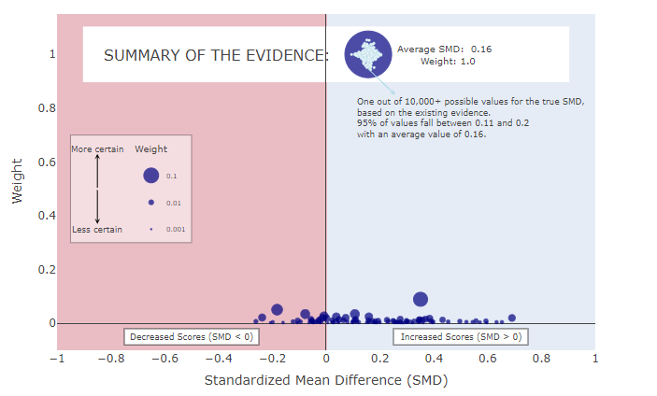
Purpose of Experiment
Notes:
Relative/rescaled weight (not raw weight) on y-axis; raw weights rescaled to add to 1
The more studies (ex: 100) there are, the less relative weight each one has
Dots pool at the bottom of the plot, making it difficult to read

Slide 9
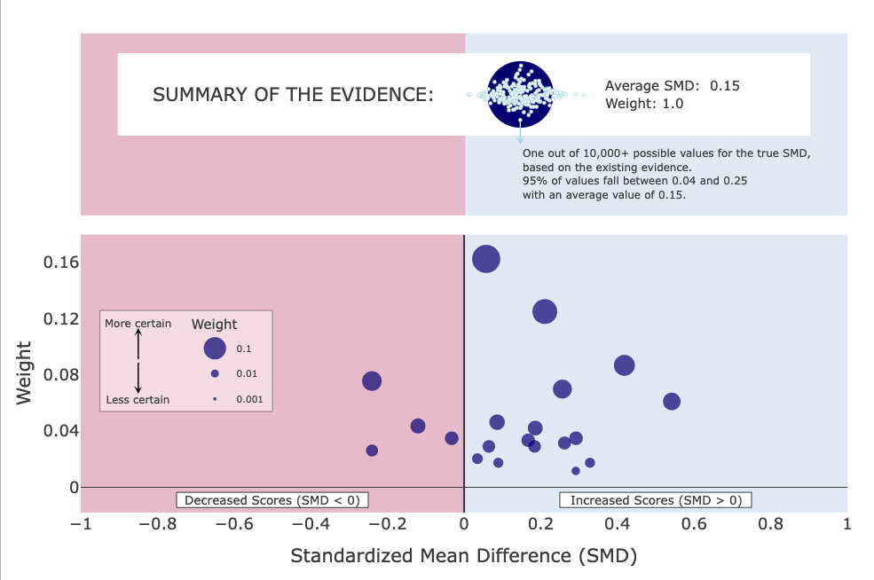
What’s the Difference?
MARC v1
MARC v2
Relative weight on y-axis
Summary effect on the same axis
Dots “pool” at the bottom, visually compact
Relative weight, rescaled y-axis
Summary effect on separate plane
Dots less visually compact, no “pooling”

Slide 10
The 4 Visualization Types
Forest Plot
MARC v1
Bar Plot
MARC v2

Slide 11
Experimental Design
16 treatment combinations: 4 visualization types * 4 levels of K (# of studies in the meta-analysis)
BP | FP | MARC v1 | MARC v2
*
K = 10 | K = 20 | K = 50 | K = 100
Notes:
Mention that these are SIMULATED meta-analyses
unreasonable/tedious to have each person answer questions about 16 visualizations
Randomly divided 160 participants into groups to answer questions about 4 of the visualizations

Slide 12
Survey Questionnaire
1. Which study’s findings do you trust the most?
2. Which study was given the most weight in determining the summary SMD?
3. Which study’s results are least certain?
4. Which study found that the new curriculum improved scores by the greatest amount?
5. On average, how much did the new curriculum increase or decrease student scores?
6. Which of the following provides the best (most certain) estimate of the true SMD?
7. Is there sufficient evidence to conclude that the new curriculum improved scores?
Notes:
Purpose: test whether or not audience can accurately extract desired info from visualizations
Each question has objectively correct answer, so participants score /7
Compare scores to compare performance of each visualization

Slide 13
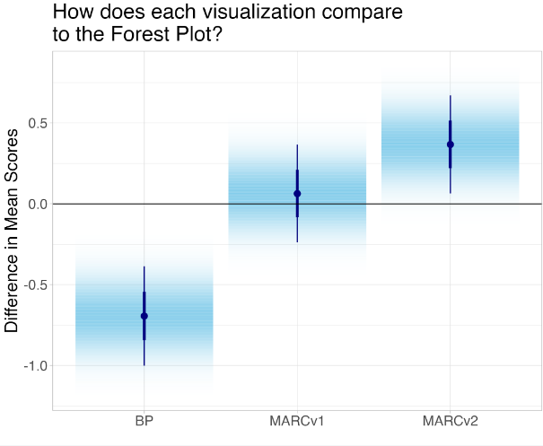
Results
MARC v2 performs best and is statistically significantly better than both the forest plot and the bar plot.
Notes:
Forest plot as baseline because it is most common visualization type in the field

Slide 14
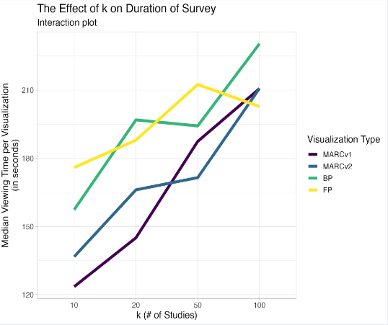
Results
For all visualization types, participants generally spend more time answering questions as k increases
Notes:
Note: lines for MARC 1 and 2 (blue and purple) tend to be lower than lines for other viz types, participants answered questions more quickly for those two visualizations

Slide 15
Key Takeaways
MARC v2 is most effective at communicating meta-analytic data for large meta-analyses and is a better alternative to the forest plot and the bar plot
Meta-analytic visualizations that make weight the most visually salient lead to the best meta-analytic reasoning

Slide 16
Key Takeaways
MARC v1
MARC v2
Even small adjustments to a visualization can make existing visualizations easier to understand

Slide 17
References
Fitzgerald, K.G, Tipton, E. (2021). The Meta-Analytic Rain Cloud Plot: A New Approach to Visualizing Clearinghouse Data. Journal for Research on Educational Effectiveness, 15:4, 848-875
Franconeri, S. L., Padilla, L. M., Shah, P., Zacks, J. M., & Hullman, J. (2021). The science of visual data communication: What works. Psychological Science in the Public Interest, 22(3), 110–161.

Slide 18
Acknowledgements
We would like to acknowledge the APU Faculty Research Council Grant for helping fund our research as well as collaborators/mentors Kaitlyn Fitzgerald, Elizabeth Tipton, and Steve Franconeri.

